Slide 1



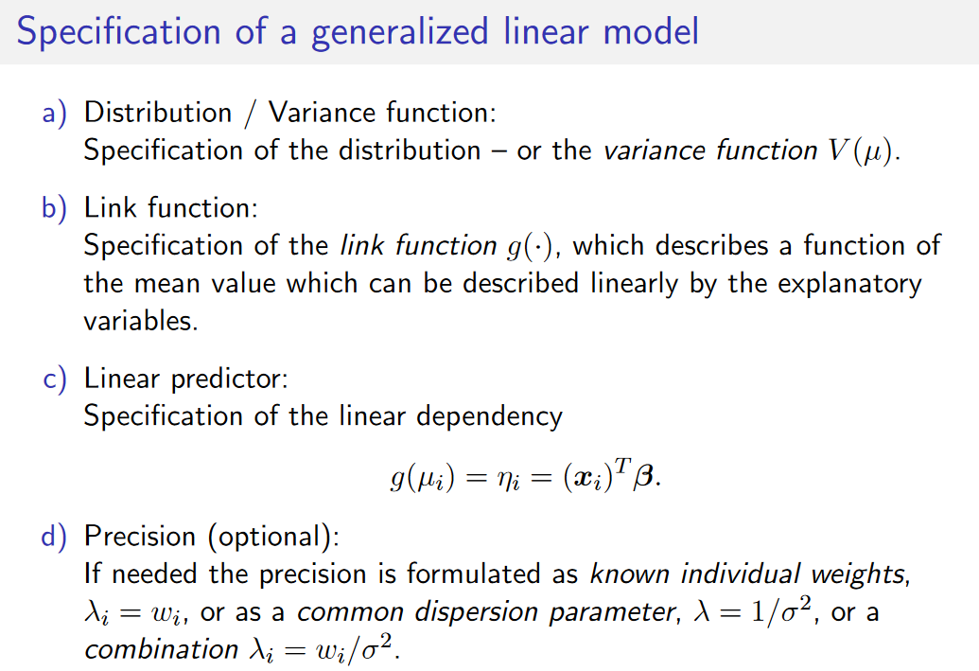

Slide 2



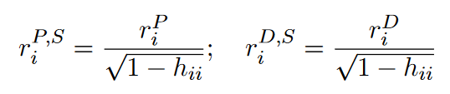
Response Residual:
Not constant which is a prob.
Deviance Residual:
Expresses difference in log likelihood
Pearson Residual:
Normalized response residuals.
Standardized Pearson and Deviance Residual:

Slide 3
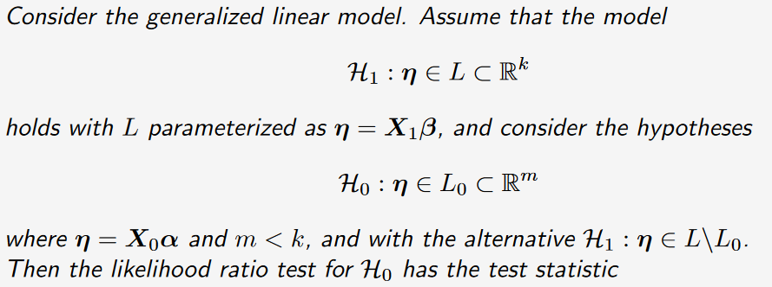


Likelihood ratio test:
$\frac{−2\log{λ(y)}}{{ σ}^{2}}\sim χ^{2}(k−m)$

Slide 4
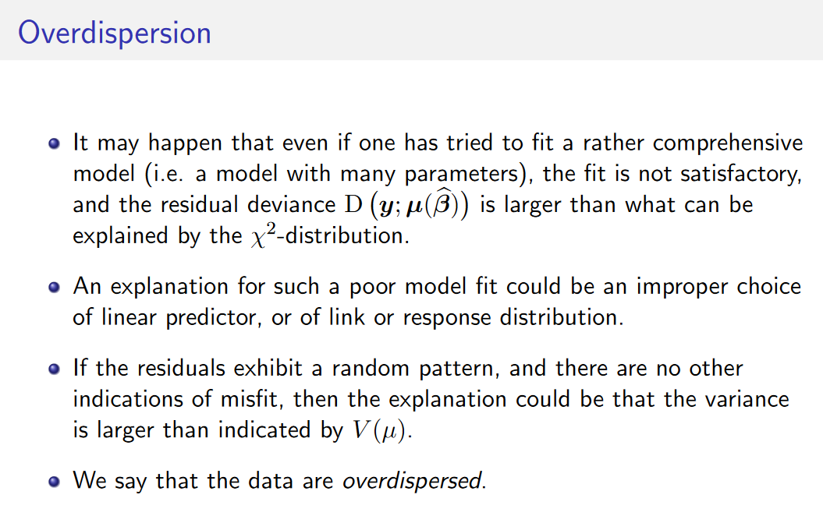

Slide 5
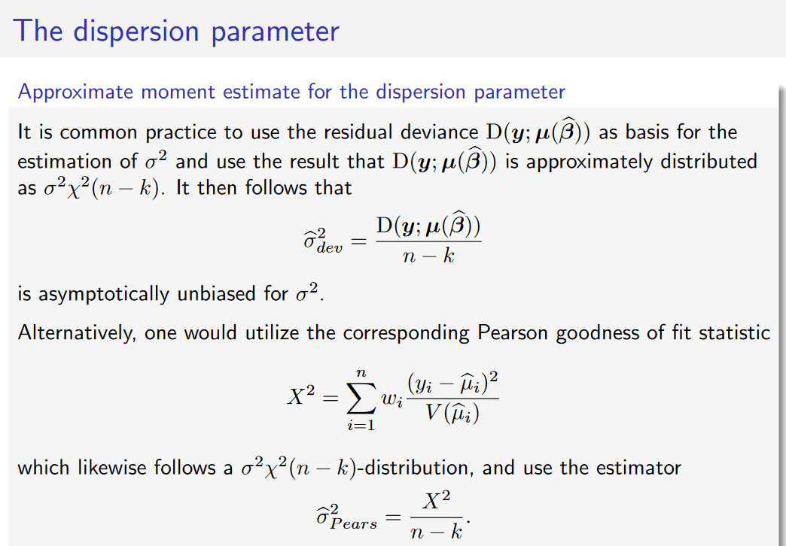

Slide 6
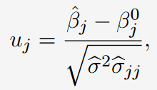
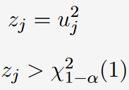
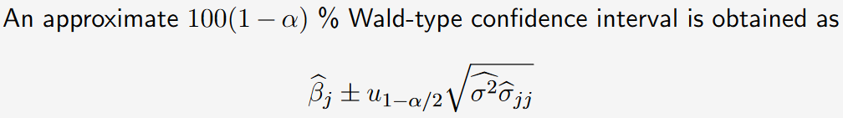
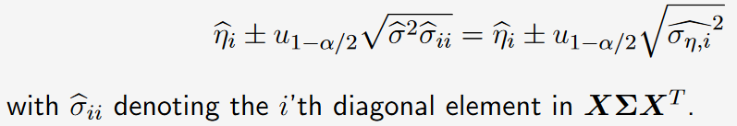
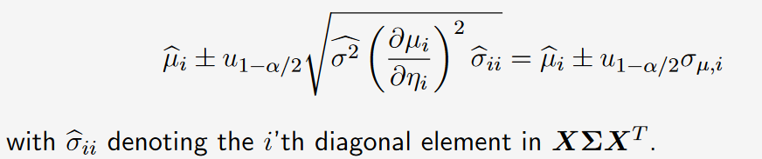
For predictions we need to simulate

Slide 7
